Slide 1
The Role of Foundational Relations in the Alignment of Biomedical Ontologies
Barry Smith
and
Cornelius Rosse

Slide 2
Relations in the UMLS Semantic Network
54 types of relations
yielding a graph containing more than 6,000 edges

Slide 3
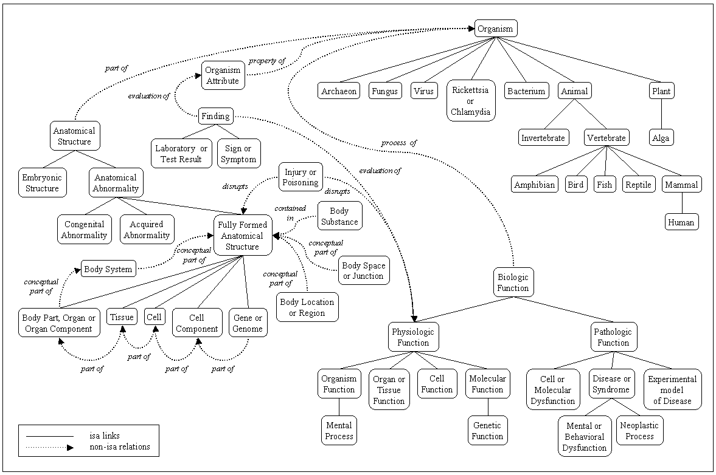
what are the nodes in this graph?

Slide 5
“concepts”
first of all: linguistic entities
(≈ meanings)

Slide 6
Fruit
SimilarTo
Vegetable
NarrowerThan
Orange
Apfelsine
SynonymWith
Goble & Shadbolt

Slide 7
UMLS SN
is_a =_{def.}
if one item ‘is_a’ another item then the first item is more specific in meaning than the second item

Slide 9
How can concepts/meanings figure as relata of relations such as contains or disrupts ?

Slide 10
contains =def. holds or is the receptacle for fluids or other substances.
How can concepts/meanings serve as receptacles for fluids or other substances?

Slide 11
connected_to =def. directly attached to another physical unit as tendons are connected to muscles
How can a concept/meaning be directly attached to another physical unit?

Slide 12
causes =def. Brings about a condition or an effect. Implied is that an agent, e.g., a pharmacologic substance or an organism, has brought about the effect
Vitamin causes Injury or Poisoning
Bacterium causes Experimental Model of Disease

Slide 13
‘concepts’
Swimming is healthy and contains 8 letters

Slide 14
Solution
talk not of concepts = creatures of cognition
and classes (types, kinds, universals) = invariants out there in reality
Foundational Model of Anatomy (FMA) is an ontology of classes in this sense

Slide 15
The Gene Ontology
error prone
in part because of its sloppy treatment of relations
menopause part_of death

Slide 16
Open Biological Ontologies
http://obo.sourceforge.net/
OBO library of controlled vocabularies developed for shared use across different biological domains.
Gene Ontology plus: Cell Ontology, Sequence Ontology, etc.

Slide 17
To support integration of ontologies
relational expressions such as
is_a
part_of
...
should be used in the same way by the ontologies to be integrated
should be coherently defined

Slide 18
To define bio-ontological relations we need to take account of both components and processes
(= continuants and occurrents)
Components are that which changes; they are the bearers of processes.
cell participates_in cell division

Slide 19
OBO Relations Ontology:
is_a
part_of
develops_ from
derives_ from
located_at
participates_in
adjacent_to
contained_in
precedes
has_function

Slide 20
to define these relations properly
we need to take account of both classes and instances

Slide 21
Kinds of relations
<class, class>: is_a, part_of, ...
<instance, class>: this mitosis instance_of the class mitosis
<instance, instance>: Mary’s heart part_of Mary

Slide 22
Instance-level relations
part_of
is_located_at
participates_in
agent_of
earlier
. . .

Slide 23
Taking the instance-level part_of as primitive
we can define:
C₁ part_of C₂ means: any instance of C₁ is part_of some instance of C₂
nucleus part_of cell
but not:
testis part_of human

Slide 24
from C₁ part_of C₂ we cannot infer that C₂ has_part C₁
human_testis part_of human
but not
human has_part human testis
running has_part breathing
but not
breathing part_of running

Slide 25
Develops_ from
a fetus develops_from an embryo
an adult develops_from a child
C₂ develops_ from C₁ =def. any instance of C₂ was at some earlier time an instance of C₁

Slide 26
C
c at t
C₁
c at t₁

Slide 27
Derives_from
a sequence of cell divisions in which the successive daughter cells are not identical with the parent cells which existed before division
C₁ derives_ from C =def. any instance of C₁ is such that there was at some earlier time an instance of C of which it formed an instance-level part

Slide 28
the initial component ceases to exist with the formation of the new component
C
c at t
C₁
c₁ at t₁
the new component detaches itself from the initial component, which itself continues to exist
C
c at t
c at t₁
C₁
c₁ at t

Slide 29
neuron derives_from neuroblast
muscle cell derives_from myoblast

Slide 30
Has-function
your heart has the function: to pump blood
= your heart is predisposed (has the potential or casual power) to realize a process of the type pumping blood.
agent_of (instance-level relation)
C has_function P =def. any instance of C is an agent_of some instance of P

Slide 31
OBO Relations Ontology:
is_a
part_of
develops_ from
derives_ from
located_at
participates_in
adjacent_to
contained_in
precedes
has_function

Slide 32
Conclusion
How do we know if this ontology is correct?
It will be used by OBO and similar ontologies
It will elp us to avoid characteristic coding errors associated with development of such ontologies hitherto

Slide 33
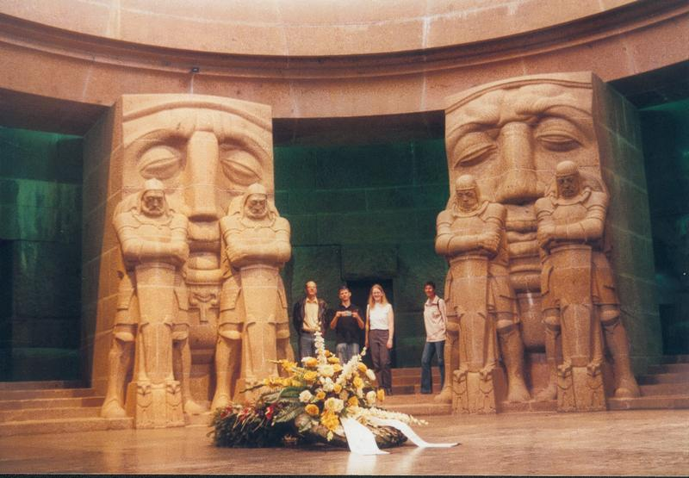
The End

